Slide 1
ZAPATISTA Incredible Indigenous Movement for a Good Society
CHIAPAS , MEXICO
Started 1994
Notes:
Movement has derived its name from Emiliano Zapata, a hero of the Mexican Revolution. His rallying cry was tierra y libertad (Land and freedom)

Slide 2
What is the Zapatista Movement ?
By indigenous people of Chiapas state of Mexico
An anti-globalization, anti-neo liberalism movement; anti INDUSTRIALISM movement
An indigenous rights movement.
A Movement for rebuilding a new future of hope, liberation, inclusivity and gender equality
And of ecological consciousness!

Slide 3
How Big is the Zapatista Movement ?
3.5 lakh people
More than 1000 villages / communities
Organized into 29 Marez or Municipalities ( equivalent to our blocks )
Federating into 5 Caracoles ( equivalent to our districts )

Slide 4
Zapatismo Philosophy
And
Principles

Slide 5
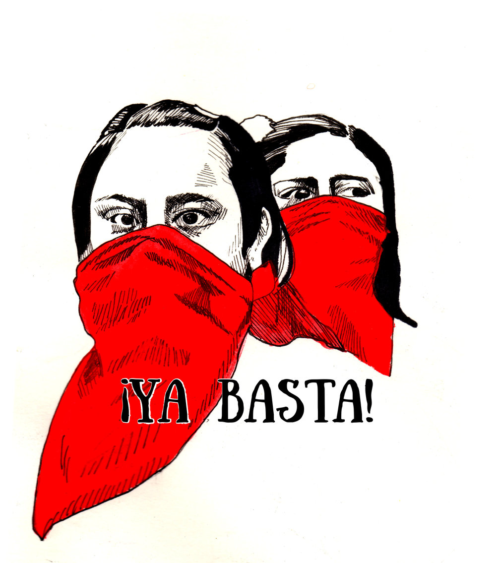
Enough!
Notes:
Map/ NAFTA /// 1 Jan 1994: Ejercito Zapatista Denacional Liberation (EZDL) occupied 4 Chiapian towns : first post modern revolution of indigenous people

Slide 6
“Un Munde Done Quepoan Muchos Mundos”
A world where many worlds fit

Slide 7
“You are in Zapatista Territory. Here the people lead and the government obeys “

Slide 8
Preguntando Caminamos
“Asking, We Walk”
None of us have all the answers.

Slide 9
Slow but Advancing
Notes:
Today the symbol of the caracol expresses the ideals of small community government

Slide 10
Cuando Una Mujer Avanza,
No Hay Hombre Que Retrocede
When a Woman Advances,
No Man is Left Behind
Notes:
Contrast with the popular saying of behind every successful man is a woman. Look at body language.

Slide 11
“from below and the left”
work collectively
from the heart
and from a position
of lower social status
that does not seek prestige

Slide 12
“Para Todos Todo,
Para Nosotros Nada”
Everything for everyone, Nothing for us!

Slide 13
ZAPATISTA
HISTORY

Slide 14
1 January 1994
An armed rebellion by the rag tag army –EZLN - Zapatista Army of National Liberation
that had one-third women
occupied a Chiapas town called San Cristóbal, Mexico after a decade of being underground
demanding “work, land, housing, food, health, education, culture, independence, liberty, democracy, justice and peace”

Slide 15
EZLN
Ejército Zapatista de Liberación Nacional
Zapatista National Liberation Army

Slide 16
New Year revolt 1994– brief armed uprising
EZLN guerillas liberated political prisoners, stormed military barracks, occupied government offices, set fire to trumped-up files
and announced Zapatista ‘Women’s Revolutionary Law.’
In the rural countryside, Zapatista soldiers also reclaimed dispossessed land by kicking affluent property-owning bosses off plantation
The skirmishes and exchange of bullets between the EZLN and federal army lasted a total of only 12 days, after which a ceasefire was negotiated.

Slide 17
From 1994
Massive violent clampdown by the Mexican government
Followed by a decade of repression- Human Rights Watch uncovering mass graves/ torture accounts/ killing of key leaders / and false promises and betrayals by the government
March and protests by people in Mexico city and all over the world against state repression on Zapatistas
EZLN is now known for its peaceful mobilizations, dialogue with civil society and direct democracy structures

Slide 18
Why 1st Jan 1994?
the day of NAFTA : the North American Free Trade Agreement signed by Mexico
a triblock treaty -Mexico; United States and Canada; to eliminate trade tariffs.
But NAFTA - a "death certificate" for Mexico's indigenous farmers
Involved mass importation of U.S. government-subsidized corn
And Mexican government revoking rights of farmers to their small holdings

Slide 19
Shocking? or long time coming revolt in 1994?
From the forgotten Chiapas: a highly marginalized and resentful and abused population -- indigenous people --stripped of their lands, and in many cases turned into almost slaves on their own land
“A popular uprising against government-backed globalization led by an all but forgotten people: it was an event that seemed unthinkable. And yet surging out of the jungles came a movement of people with no market value and the audacity to refuse to disappear.”
Notes:
// Chiapas population vs Mexico population and area indigenoeus percentage of population in chiapas and in mexico// Quotes from Laura Gottesdiener, 2014, independent journalist, thenation.com and Ryan Mallett-Outtrim (2016) , LINKS

Slide 20
We cover our faces so that you can see us
Notes:
Recognized by their black ski masks and red bandanas

Slide 21
Mexico – Chiapas – Zapatistas
Mexico total population : 123 M
Indigenous population : 20 M
Chiapas population : 5 M
Indigenous population in Chiapas : 1.5 M ( 30 %)
Zapatistas : 3.5 L ( 7 % of Chiapas population ; 25 % of indigenous population of Chiapas )
Notes:
Source: the United Nations Department of Economic and Social Affairs (2017) based on 2010 census data ; https://www.un.org/development/desa/family/wp-content/uploads/sites/23/2018/05/2-1.pdf
https://en.wikipedia.org/wiki/Rebel_Zapatista_Autonomous_Municipalities#cite_note-6
https://anarchyinaction.org/index.php?title=Zapatista-run_Chiapas#cite_note-1
2. https://en.wikipedia.org/wiki/Demographics_of_Mexico

Slide 22
Homogenous territory & people ?
1000 villages / communities
Tzeltal, Tzozil, Chol, Tjolobal, Zoque, Kanjobal and Mame indigeneous communities are part of the Zapatistas
Many villages are mixed. Indigenous and non-indigenous.
Among indigenous : Zapatistas and non-Zapatistas .
Notes:
Source: the United Nations Department of Economic and Social Affairs (2017) based on 2010 census data ; https://www.un.org/development/desa/family/wp-content/uploads/sites/23/2018/05/2-1.pdf
https://en.wikipedia.org/wiki/Rebel_Zapatista_Autonomous_Municipalities#cite_note-6
https://anarchyinaction.org/index.php?title=Zapatista-run_Chiapas#cite_note-1
2. https://en.wikipedia.org/wiki/Demographics_of_Mexico

Slide 23
Leadership
Enigmatic leader, Subcomandante Marcos, helped galvanise support from civil society groups, Now known as Subcomandate Galeano
Stepped down in 2017 and gave way to an indigenous woman leader María de Jesús Patricio Martínez .

Slide 24
What is the
Zapatista Story ?

Slide 25
I’ve said it before — in contrast to those traditional stories that begin with ‘Once upon a time…’
Zapatista stories begin with ‘There will be a time…’—
Subcomandante Galeano (formerly Marcos)

Slide 26
Their Political & Governance Structures
The Role and Position of Women
Their Education systems
Their Economy
Their Health systems
Their philosophy, principles, strategies
Current Situation and Future

Slide 27
“Zapatismo is neither a model, nor doctrine. It’s also not an ideology or blueprint, rather, it is the intuition one feels inside their chest to reflect the dignity of others, which mutually enlarges our hearts.”- Educator
“Power was trying to teach us individualism and profit…We were not good students.” Educator
“We are not here to command, because once that starts to happen, we are dead”.
But hope that it may spark in others to be Zapatistas wherever you are”

Slide 28
Seven principles of Zapatismo
1. Obedecer y no Mandar (to obey, not command)
2. Proponer y no Imponer (to propose, not impose)
3. Representar y no Suplantar (to represent, not supplant)
4. Convencer y no Vencer (to convince, not conquer)
5. Construir y no Destruir (to construct, not destroy)
6. Servir y no Servirse (to serve, not to serve oneself)
7. Bajar y no Subir (to go down, not up; to work from below, not seek to rise)

Slide 29
Rejection of Mexican Nation State
Oventic: capital of EZLN
Register their own births
Rejected Red Cross aid even for the refugees of a region displaced by war
Do not receive Government Aid. Do not pay tax
Most of the movement’s work over the last two decades has involved patiently building autonomous structures

Slide 30
Structure
A confederation of participatory democracies
Operates at 3 levels: the community, the autonomous municipality ( Marez) , and the region ( Caracole) .
Over 1000 communities confederate into 29 MAREZ
29 MAREZ confederate into five caracoles (Spanish for "snails")

Slide 31
Level 1: Governance at community level
3 main administrative structures: (1) the commissariat, in charge of day-to day administration; (2) the council for land control, which deals with forestry and disputes with neighboring communities; and (3) the agencia, a community police agency.
At a local level, people attend a general assembly of around 60 families where anyone over the age of 12 can participate in decision-making.
These assemblies strive to reach a consensus but are willing to fall back to a majority vote.

Slide 32
Level 2: MAREZ/ Municipality
Coordinated by Autonomous Councils
Main objectives to promote education and health in their territories.
Also fight for land rights, labor and trade, housing, and fuel-supply issues, promoting arts (especially, indigenous language and traditions),
And administering justice.
Notes:
https://docs.google.com/file/d/0B3RELkjXfmoWWF8tOFFyRGNkbnM/edit

Slide 33
“ As autonomous authorities we can’t impose our ideas, we can only present our proposals. Then the people have to approve our proposals, because the people are the highest authority”
- Citali, a good government council member

Slide 34
Level 3: Caracoles
In 2003: About 10 years after the revolution , the EZLN announced the creation of five caracoles
Here they formed Juntas de Buen Gobierno [Good Government Councils]
This provides a third, zone-wide level of self-government for the Zapatista communities and autonomous municipalities.

Slide 35
Caracol means Snail
It means
Tempo of the rebellion is slow
And yet it is advancing
In gradual, measured rhythms
Essentially : Move forward purposefully by defining time on their own terms(ancient Mayan terms)

Slide 36
Indigenous Worldview in slogans One for each of the 5 Caracoles
Mother of the sea, snails of our dreams
Whirlwind of our words
Resistance toward a new dawn
That speaks for all
Resistance and rebellion for humanity

Slide 37
Caracoles : Who are the members (staff) ?
The members of Good Government Boards serve only 10-14 days of each month and for only three years.
At first the Good Government Board members received a salary, but the Zapatistas quickly abolished monetary compensation to these delegates.
Instead, Good Government Board members receive food or some other non-monetary assistance from their communities, such as help with their farmland while they are serving in government.
Notes:
As opposed to bad government!
https://schoolsforchiapas.org/blog-entry-zapatista-autonomy/

Slide 38
There is no standard way that these representatives are chosen – the autonomy is indeed autonomous
But frequently they are people who have served as community authorities, proven themselves, and then been selected to serve at a higher level.
Prospective representatives don’t go out and campaign
There can be a combination of the community naming someone at an assembly, or someone also desiring to serve and making that known.

Slide 39
The number of days this group serves on the Junta varies depending on the Caracol. In some they serve 10, in some 14 days.
Holding a position of authority- means carrying your share of weight.
So seen as hardship as well as honour!!!
Closely scrutinized by peers and also subjected to heavy criticism .

Slide 40
Task of Caracoles Board
The Good Government Boards help redistribute resources and coordinate regulations between different municipalities
They deal with ongoing and new matters brought before them. When they leave, a new group arrives.
In cases of common crimes, the punishment imposed by the Autonomous Council is reparation of the damages: instead of punishment by jail or fines, a sentence is imposed of working for the community, or for the aggrieved family.

Slide 41
Women
And
Gender

Slide 42
“We are oppressed three times over, because we are poor , because we are indigenous , and because we are women”
-Commandanta Ester’s speech in Mexico City’s central plaza, 2001

Slide 43
Women’s Revolutionary Law
1. Women, regardless of their race, creed, color or political affiliation, have the right to participate in the revolutionary struggle in any way that their desire and capacity determine.
2. Women have the right to work and receive a fair salary.
3. Women have the right to decide the number of children they have and care for.

Slide 44
4. Women have the right to participate in the matters of the community and hold office if they are free and democratically elected.
5. Women and their children have the right to Primary Attention in their health and nutrition.
6. Women have the right to an education.
7. Women have the right to choose their partner and are not obliged to enter into marriage.

Slide 45
8. Women have the right to be free of violence from both relatives and strangers.
9. Women will be able to occupy positions of leadership in the organization and hold military ranks in the revolutionary armed forces.
10. Women will have all the rights and obligations elaborated in the Revolutionary Laws and regulations.

Slide 46
Zapatista women- companeros
Leadership from above established a framework for women’s rights and new opportunities
And rural indigenous women themselves rose up to fill these spaces and change their destiny
Served as insurgents, political leaders, healers, educators, key economic agents
Helped by Laws prohibiting forced marriage or any form of sexual discrimination
Also by keeping communities free from violence and addiction by outlawing drugs and alcohol.
Notes:
https://www.viewpointmag.com/2018/06/07/what-does-it-mean-to-live-notes-from-the-zapatistas-first-international-gathering-of-politics-art-sport-and-culture-for-women-in-struggle/

Slide 47
Zapatista
Education

Slide 48
We will know what type of education to provide,
If we know what type of society we want
Dewey
Key words of Zapatista Education
Autonomy, Dignity for All , Self Sufficiency, Freedom , Humans as part of Nature
Notes:
-John Dewey Quote

Slide 49
What Zapatista Education Promoters say
Autonomous Education began as response to our communities’ needs- It’s not like Government education. We began by thinking about having our own education , among ourselves.
We decided to create this new education so that we can teach and learn in our own language, with our own culture and traditions.”

Slide 50
Education: Key Principles
Aim: to be a center of learning dedicated to saving the planet.
Free, open to all ages and all people --- even non Zapatistas
Learning in multiple indigenous languages and even Spanish
Teaching and learning takes place in the health centers, in the women’s cooperatives, and in the fields (traditional Mayan corn field--the milpa.)
Education is based on the needs of the community, and hours are agreed accordingly.
Notes:
https://openrevolt.info/2011/12/28/zapatista-autonomous-education/

Slide 51
Education : What not to do
Rejection of practices that teach entrepreneurialism, individualism , or competition.
Eliminating Shame from learning
It is forbidden to hit, punish or disrespect the children.

Slide 52
What to do & What to value
Pupils are educated to take up positions of responsibility and to work for the good of the community.
“We want our children to learn about freedom and dignity and to value all human beings.”

Slide 53
Teachers / Education Promoters
Education promoters”- Local, contextual knowledge valued
No salaries; community provides food and shelter.
Learning is a shared experience.
“Here we share learning and learn from each other, it’s not like the promoters know everything. Even the youngest child can contribute.”

Slide 54
Curriculum of Self Sufficiency and Dignity
Regional indigenous languages & culture
Agro-ecology : how to work the land and to care for the earth, how to save seeds, how to use and prepare natural remedies,
Organic agroforestry
Conserving water sources and forests
Food sovereignty
Community health, natural/herbal medicines, bone-setting and midwifery

Slide 55
Political struggle, awareness of injustice , social transformation
Women’s revolutionary law
Zapatista struggle
Oral histories & Own history
Trades -- electrical wiring, artisanal crafts,
Community radio
The need to work together to build and strengthen the community and the resistance

Slide 56
School Project : Mother Seeds in Resistance
Seed bank in a school
The community( young and old) is identifying seeds to be preserved and preparing them to be frozen
Works as a seed bank and an archive, protecting cultural practices & agricultural knowledge associated with this maize crop.

Slide 57
Higher Education
Uni Tierra : an autonomous university,
CIDECI
Centro Indigena de Capacitacion Integral
‘An Indigenous Centre for Integral Learning’

Slide 58
Zapatista Little School
In 2013, the EZLN held the legendary Zapatista Little School
Over 7,000 students from all over the world attended a course given by the EZLN communities themselves under the title “Freedom According to the Zapatistas.”
One of the four Zapatista textbooks published as part of the course, Women’s Participation in Autonomous Government, documented through the Zapatista women’s own accounts of community institutions for health, literacy, political experience, and organizational leadership

Slide 59
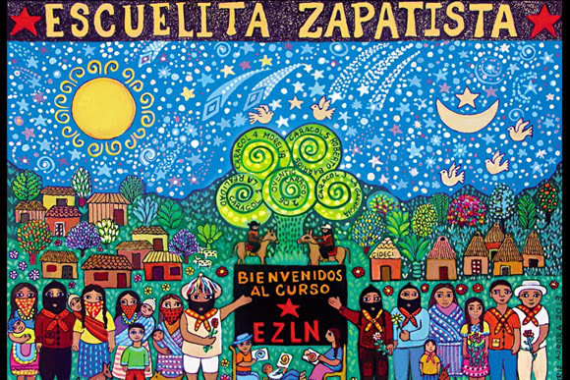

Slide 60
Zapatista
Economy

Slide 61
Agriculture
Their main crops are corn, beans, banana, coffee, sugarcane
Chicken and pigs are their main animal husbandry
Many of them are done as small cooperatives. Specially cattle cooperatives and collective cornfields on lands recovered from wealthy landowners
Bread-baking cooperatives

Slide 62
Grain Stores : at MAREZ level have been created
Production Commission store surplus grains, create barter mechanisms, provide technical support , and provide for surplus redistribution
Weaving cooperatives- The symbols woven into many of the textiles communicate not just the intended meaning of the individual artisan, but the meaning of the community as a whole, and the Zapatista movement generally.
Coffee cooperatives : Most famous . Europe and US markets

Slide 63
ZAPATISTA
HEALTH

Slide 64
Health Practice and Persons
Emphasize prevention and sanitation
Initially external visiting doctors trained the first generation of health promoters but only in Allopathy.
Now traditional practices , medicinal plants/ mid wifery etc included
Each village has a health promoter : who receive ongoing training, who provide basic preventative medical care and some of them are trained for quite high level medical care

Slide 65
Health Clinics
Health clinic in many of the municipalities
Two big hospitals with ambulances, dormitories, dentists, doctors, laboratories.
In La Garrucha an entire clinic is organized to provide for women’s health with trained midwives and a pharmacy with both western allopathic medicine and traditional healing and herbal medicine.

Slide 66
Zapatistas and the World
2010: Little School of Liberty- an international course reflecting on the Zapatista struggle. Repeated in 2013.
2016 : Art for Humanity : From July 23 to 30, over a thousand artists from 45 countries flocked to San Cristobal to participate in a festival of art, poetry and music
2017: International Science Congress – role of science in fighting oppression : “We want to understand the world, to know it. Because only by knowing the world can we make a new one, a bigger one, a better one.” –Marcos

Slide 67
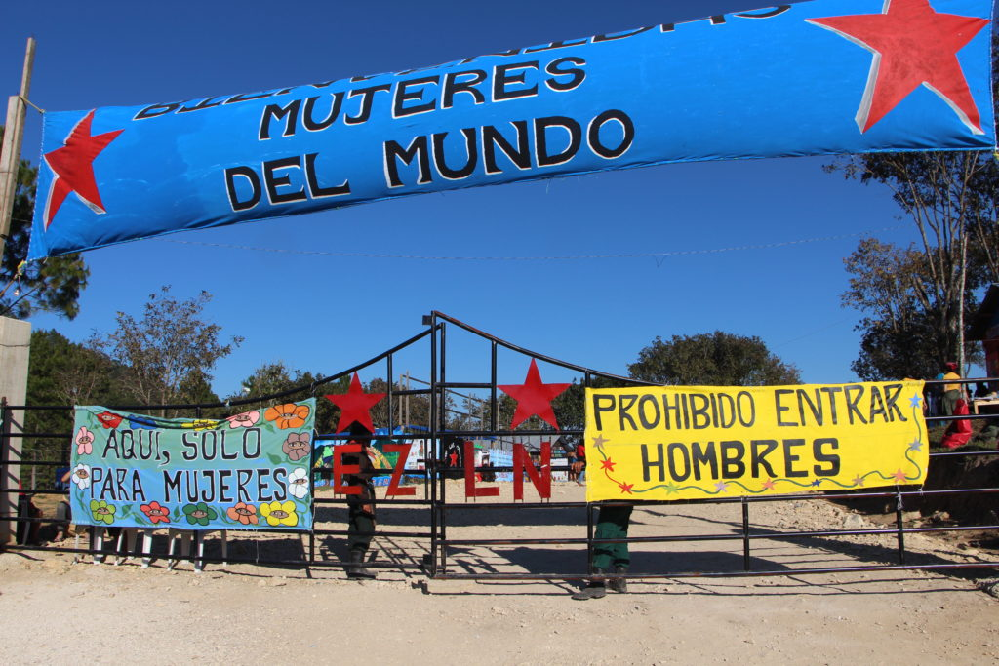
March 8-10, 2018: International Women Congress

Slide 68
Challenges today
The government and the forces of Industrialism continue to wage a propaganda war focused on convincing the rest of Mexico, the world, and even Zapatista communities themselves that the movement and its vision no longer exists.
Violence continues
Environmentalist lobby for protecting rainforest paints the Zapatistas as villains

Slide 69
Zapatismo Philosophy overview
Indigenous Worldview
Mutual Aid & Cooperation
Grassroot Democracy and Horizontal Governance
Reject the Nation State
Equitable Gender relations
Solidarity Economy- Collective Work
Own Education system for achieving the above
Autonomy rests on continuous PRACTISE and REFLECTION ; and also on dignity and respect for All.

